Slide 1
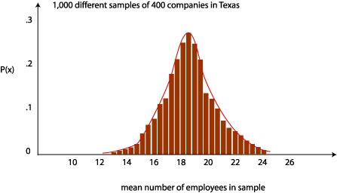
Central limit theorem
Geog4300/6300
Jerry Shannon

Slide 2
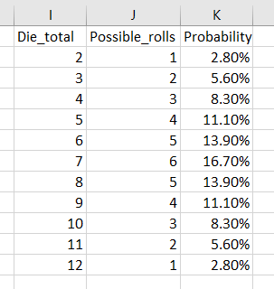
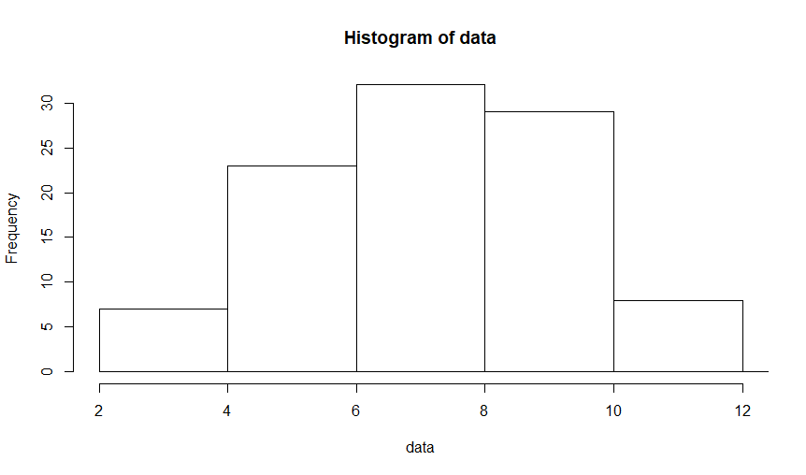
What’s the distribution of probability for rolling two dice?
Mean of 7
Standard deviation of 2.45

Slide 3
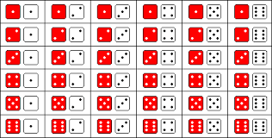
Let’s roll our dice 10 times:
https://www.random.org/dice/?num=2
What’s your mean?
What’s your standard deviation?

Slide 4
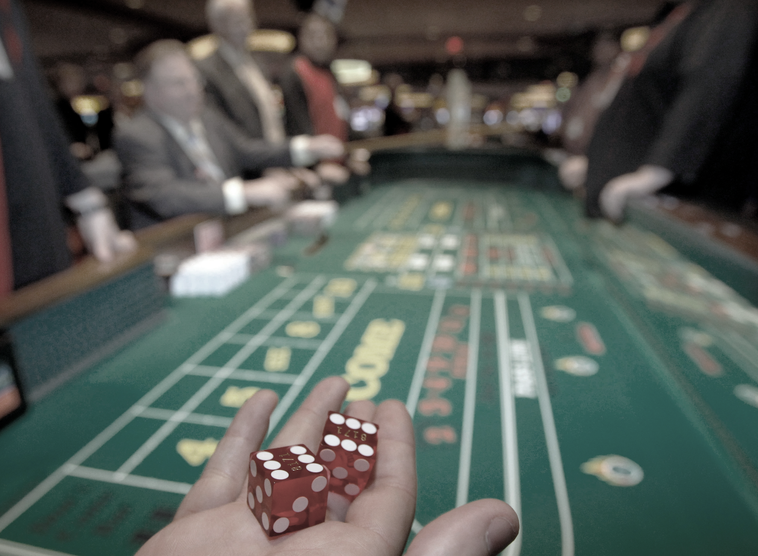
The central limit theorem:
What’s the relationship between the mean of
the sample population (your dice rolls) and
the actual population (all possible rolls)?

Slide 5
The central limit theorem describes
THREE distributions:
The actual population
A given sample of that population
All possible sample means

Slide 6
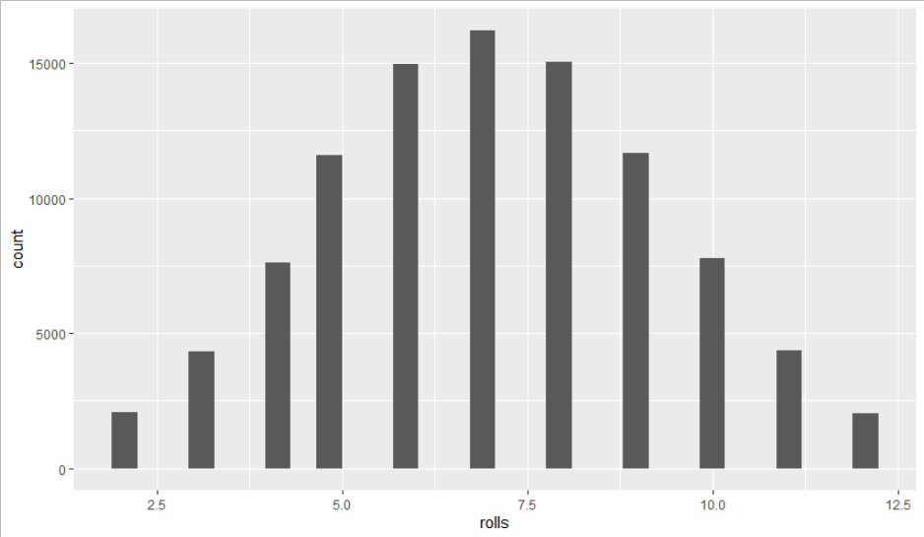
The ACTUAL population:
100,000 dice rolls. Mean of 7. SD of 2.45.

Slide 7
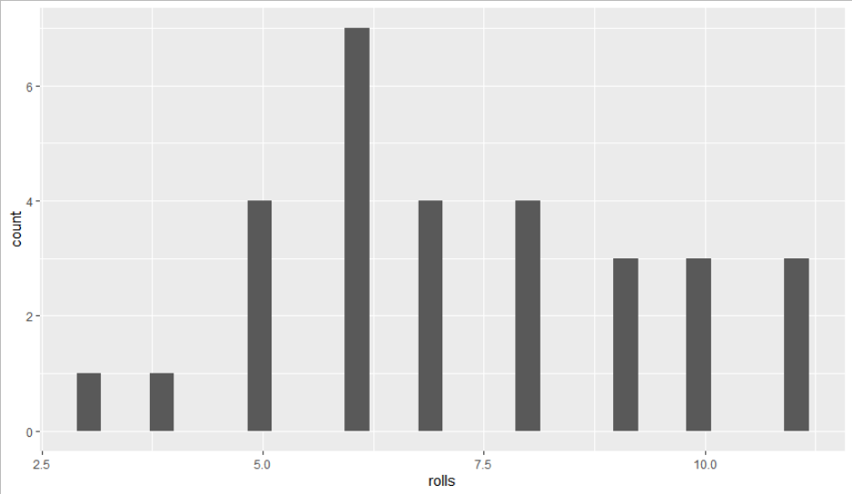
The SAMPLE population
Let’s roll two dice 30 times. Here’s the results.
Mean = 7.3, SD=2.17

Slide 8
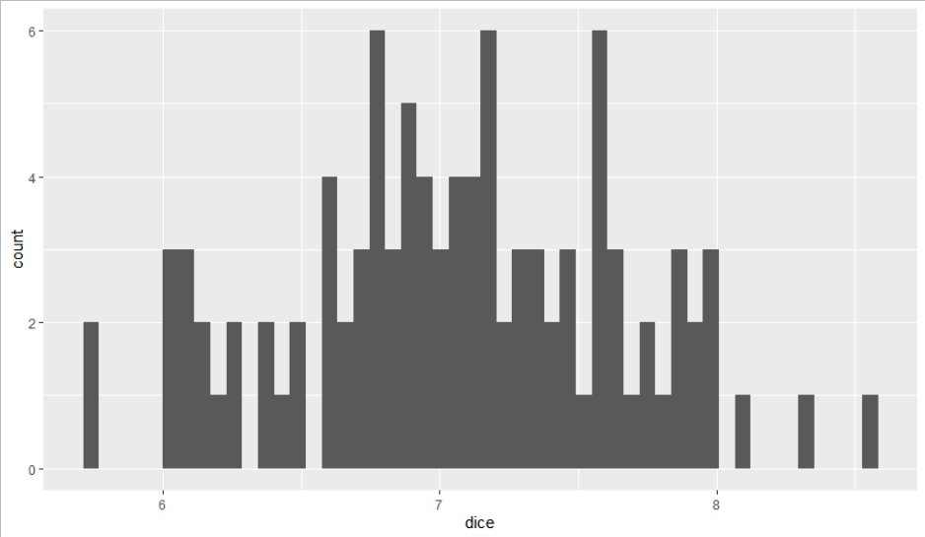
All possible SAMPLE MEANS
Now let’s look at the mean value for 100 sets of 30 rolls.
Mean = 7.06, SD = 0.6

Slide 9
Three types of distributions
Population
Sample
Sampling mean

Slide 10
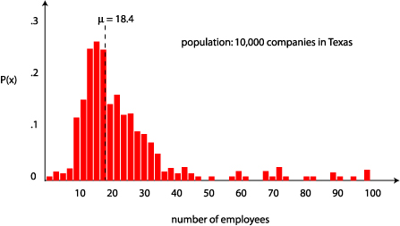
The ACTUAL population:
10,000 companies in Texas
Variable: number of employees

Slide 11
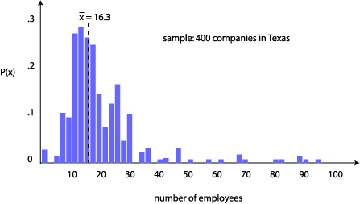
The SAMPLE population
Let’s take a sample of 400 companies.
How does this mean ( x ) compare to the actual population mean (μ)?

Slide 12

All possible SAMPLE MEANS
Now let’s take 1,000 more samples of 400 companies.
What would the distribution of their means look like? How would they compare to the actual mean?

Slide 13

Three types of distributions
Population
Sample
Sampling mean

Slide 14
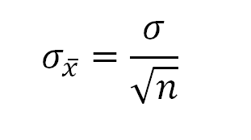
Central Limit Theorem
The sampling distribution, comprised of the means of all possible samples, will:
have a mean that is the same as the population mean
approximate a normal distribution, even if the sample distribution is not normal
have a standard deviation equal to the following formula:

Slide 15
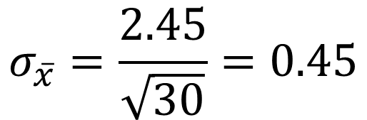
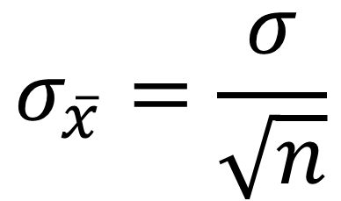
Standard Error of the Mean
It’s the standard deviation of the sampling mean
Used to estimate variability of sampling distributions
$$σ_{\overline{x}}=\frac{σ}{\sqrt{n}}$$
Mean = 7.06, SD = 0.6
$$σ_{\overline{x}}=\frac{2.45}{\sqrt{30}}=0.45$$

Slide 16
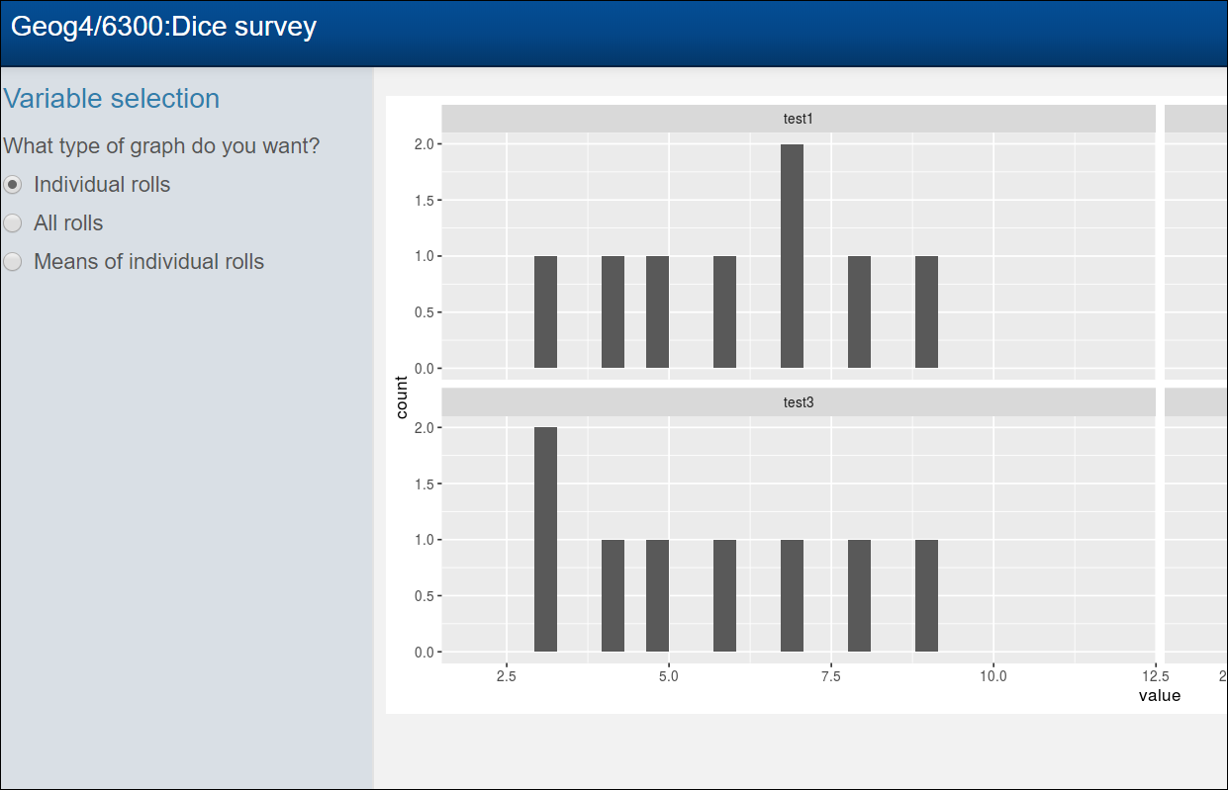
Check out our dice survey data
https://comapuga.shinyapps.io/dicesurvey/

Slide 17
Try it out!
The mean and standard deviation for all dice rolls is 7 and 2.45.
What’s the standard error of the mean for 10 dice rolls?
How many of us had means within this standard error?

Slide 18
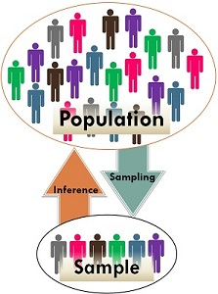
Why it matters:
The central limit theorem allows us to say something about large populations using only relatively small samples.

Slide 19

What percentage of values fall within one sd of the mean? Two sd of the mean?
If we take ONE random sample, where will it likely fall in the distribution of sampling means?
Sampling mean

Slide 20
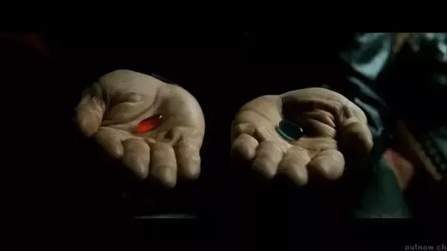
The central limit theorem is a foundational concept for statistical probability.

Slide 21
A question…
Let’s say we got property tax rates for 20 random counties in Georgia (out of 159).
The average was 8.085% (with a s.d. of 0.88)
How close is this to the actual mean?

Slide 22
Lecture break

Slide 23

Goal: be 95% confident that we know what the true mean might be.
We will create a
confidence interval
from these values that will probably include the mean.
Notes:
T distribution was created by William Gosset. Hired in 1902 at Guinness brewery to help maximize quality of beer at a lower cost.
Problem of how to measure taste with only small sample sizes (limit on how much beer one man can drink)
He had to publish his results without his name because of the privacy restrictions Guinness put on their employees. Just the name “Student”.
Thus his statistical method is still known today as Gosset’s t-test.

Slide 24

What we know:
95% of sample means are within 1.96 times the standard error of the actual mean
Notes:
T distribution was created by William Gosset. Hired in 1902 at Guinness brewery to help maximize quality of beer at a lower cost.
Problem of how to measure taste with only small sample sizes (limit on how much beer one man can drink)
He had to publish his results without his name because of the privacy restrictions Guinness put on their employees. Just the name “Student”.
Thus his statistical method is still known today as Gosset’s t-test.

Slide 25
The opposite is also true!
For 95% of samples, the true mean is within 1.96 * SE of the sample mean.
Notes:
T distribution was created by William Gosset. Hired in 1902 at Guinness brewery to help maximize quality of beer at a lower cost.
Problem of how to measure taste with only small sample sizes (limit on how much beer one man can drink)
He had to publish his results without his name because of the privacy restrictions Guinness put on their employees. Just the name “Student”.
Thus his statistical method is still known today as Gosset’s t-test.

Slide 26
This is a confidence interval:
Sample mean +/- 1.96 * SE
Notes:
T distribution was created by William Gosset. Hired in 1902 at Guinness brewery to help maximize quality of beer at a lower cost.
Problem of how to measure taste with only small sample sizes (limit on how much beer one man can drink)
He had to publish his results without his name because of the privacy restrictions Guinness put on their employees. Just the name “Student”.
Thus his statistical method is still known today as Gosset’s t-test.

Slide 27
A question (again)…
Let’s say we got property tax rates for 20 random counties in Georgia (out of 159).
The average was 8.085% (with a s.d. of .88)
How close is this to the actual mean?

Slide 28
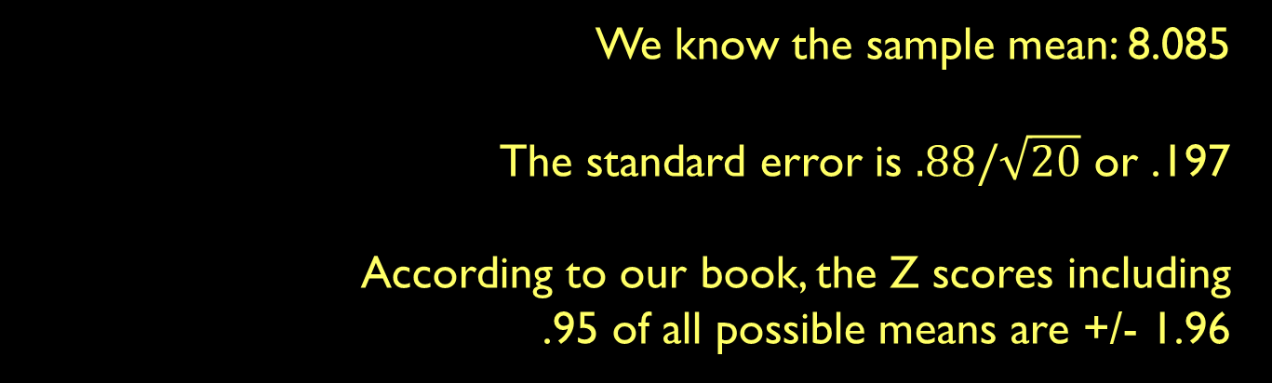
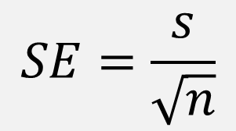
Our mission: Confidence intervals
Three ingredients for a confidence interval:
Sample mean
Standard error
Z-score for the confidence interval
Notes:
T distribution was created by William Gosset. Hired in 1902 at Guinness brewery to help maximize quality of beer at a lower cost.
Problem of how to measure taste with only small sample sizes (limit on how much beer one man can drink)
He had to publish his results without his name because of the privacy restrictions Guinness put on their employees. Just the name “Student”.
Thus his statistical method is still known today as Gosset’s t-test.

Slide 29
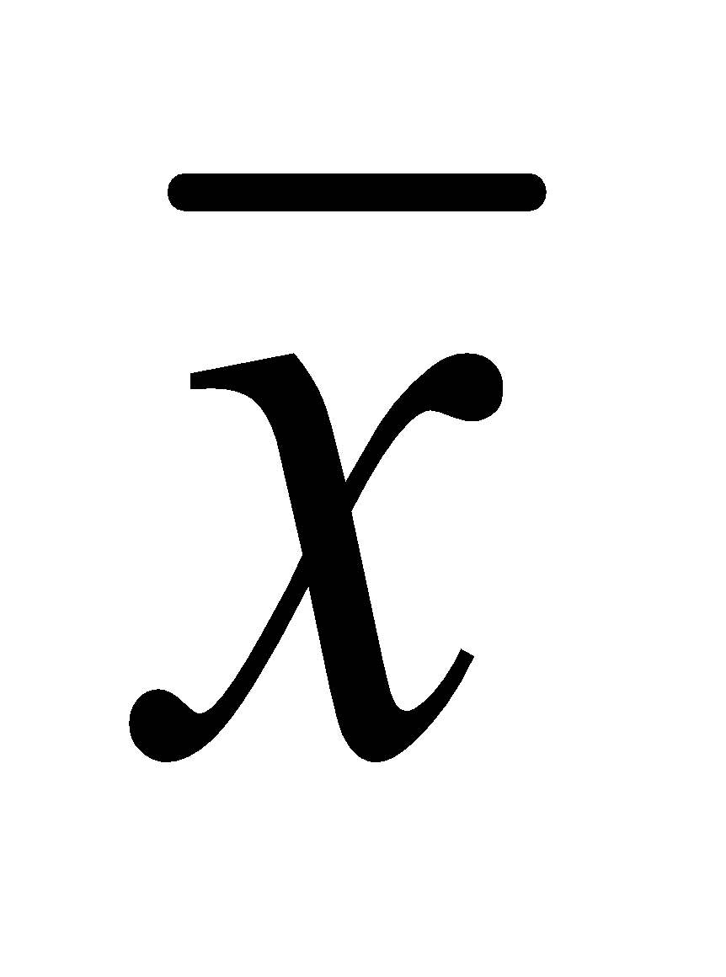
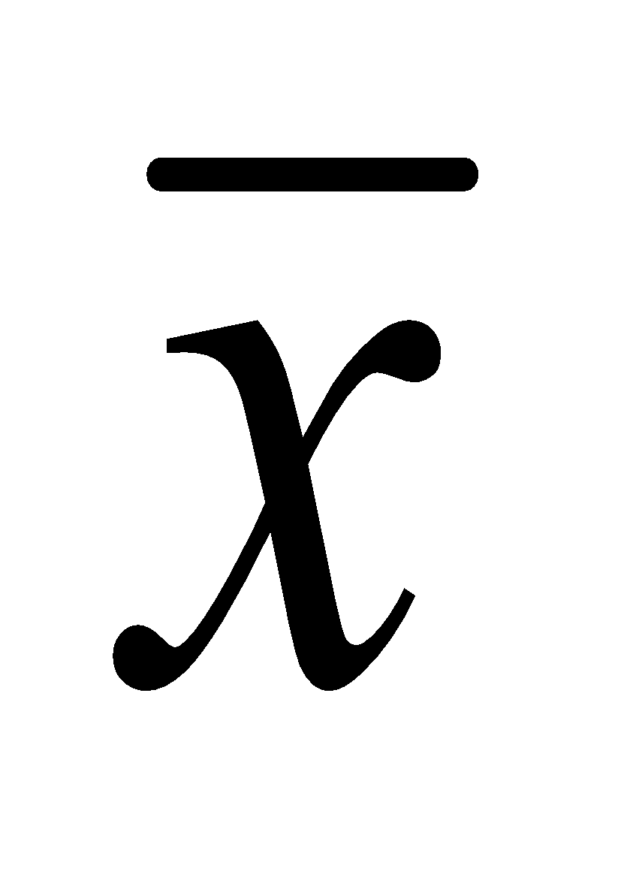
To make a confidence interval
- (z * SE) < μ < + (z * SE)
In our case, 8.08 – (1.96 * 0.197) < μ < 8.08 + (1.96 * 0.197) 7.69 < μ < 8.47
We are 95% certain that the true mean lies somewhere in this range
Notes:
T distribution was created by William Gosset. Hired in 1902 at Guinness brewery to help maximize quality of beer at a lower cost.
Problem of how to measure taste with only small sample sizes (limit on how much beer one man can drink)
He had to publish his results without his name because of the privacy restrictions Guinness put on their employees. Just the name “Student”.
Thus his statistical method is still known today as Gosset’s t-test.

Slide 30
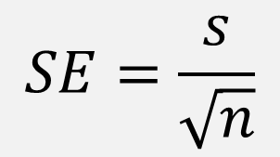
Try it out
- z * SE < μ < + z * SE
Calculate the mean and sd for your 10 dice rolls.
What’s the confidence interval for this result? Does it include the actual mean (7)?
Notes:
T distribution was created by William Gosset. Hired in 1902 at Guinness brewery to help maximize quality of beer at a lower cost.
Problem of how to measure taste with only small sample sizes (limit on how much beer one man can drink)
He had to publish his results without his name because of the privacy restrictions Guinness put on their employees. Just the name “Student”.
Thus his statistical method is still known today as Gosset’s t-test.

Slide 31
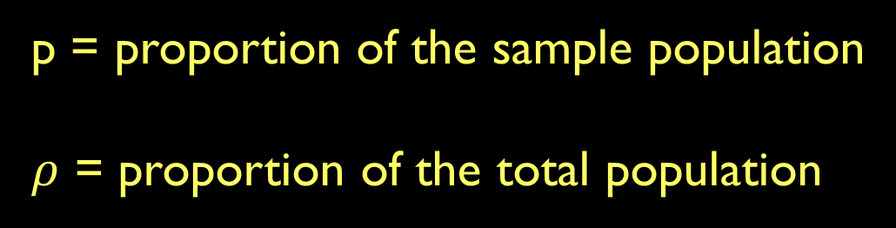
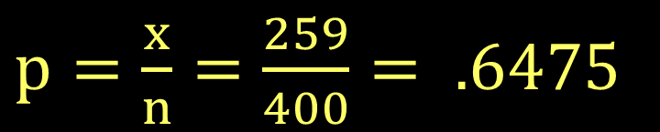
What if you have a proportion?
When 400 geographers were polled, 259 of them voted for holding the next AAG convention in Maui. What’s the actual opinion on this issue?
Notes:
T distribution was created by William Gosset. Hired in 1902 at Guinness brewery to help maximize quality of beer at a lower cost.
Problem of how to measure taste with only small sample sizes (limit on how much beer one man can drink)
He had to publish his results without his name because of the privacy restrictions Guinness put on their employees. Just the name “Student”.
Thus his statistical method is still known today as Gosset’s t-test.

Slide 32
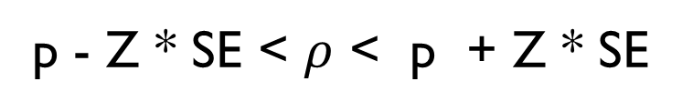
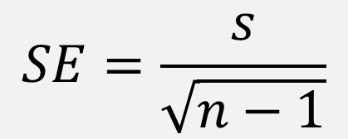
When 400 geographers were polled, 259 of them voted for holding the next AAG convention in Maui. What’s the actual opinion on this issue?
!Alert!
Data doesn’t have a standard deviation!
Standard error will not compute!
Notes:
T distribution was created by William Gosset. Hired in 1902 at Guinness brewery to help maximize quality of beer at a lower cost.
Problem of how to measure taste with only small sample sizes (limit on how much beer one man can drink)
He had to publish his results without his name because of the privacy restrictions Guinness put on their employees. Just the name “Student”.
Thus his statistical method is still known today as Gosset’s t-test.

Slide 33
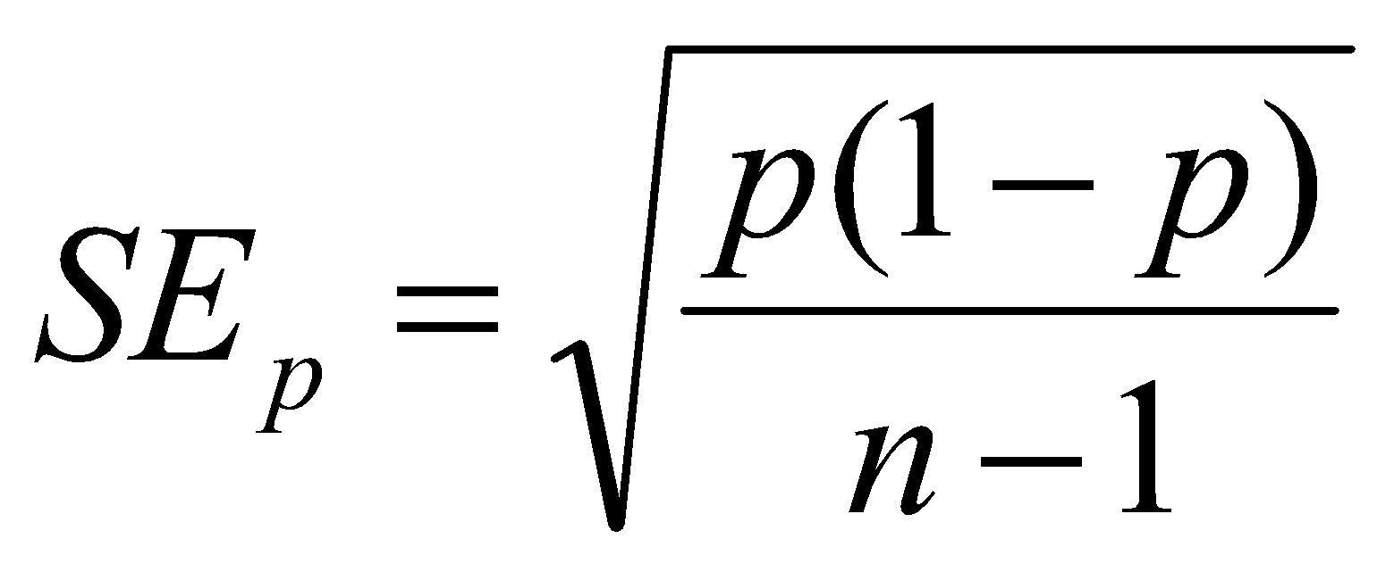
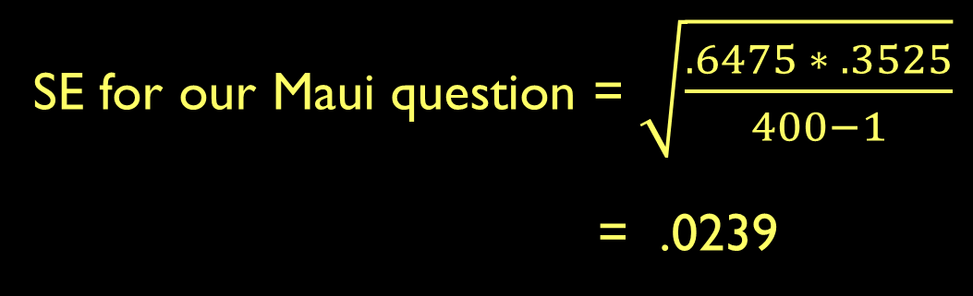
Standard error for proportions
Notes:
T distribution was created by William Gosset. Hired in 1902 at Guinness brewery to help maximize quality of beer at a lower cost.
Problem of how to measure taste with only small sample sizes (limit on how much beer one man can drink)
He had to publish his results without his name because of the privacy restrictions Guinness put on their employees. Just the name “Student”.
Thus his statistical method is still known today as Gosset’s t-test.

Slide 34
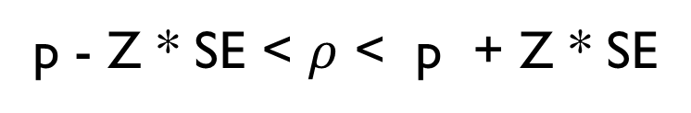
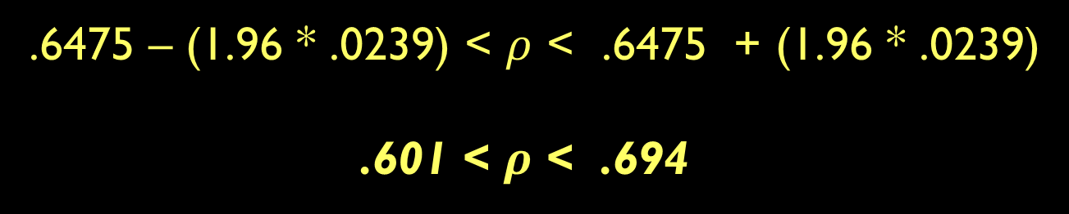
When 400 geographers were polled, 259 of them voted for holding the next AAG convention in Maui. What’s the actual opinion on this issue?
Notes:
T distribution was created by William Gosset. Hired in 1902 at Guinness brewery to help maximize quality of beer at a lower cost.
Problem of how to measure taste with only small sample sizes (limit on how much beer one man can drink)
He had to publish his results without his name because of the privacy restrictions Guinness put on their employees. Just the name “Student”.
Thus his statistical method is still known today as Gosset’s t-test.

Slide 35
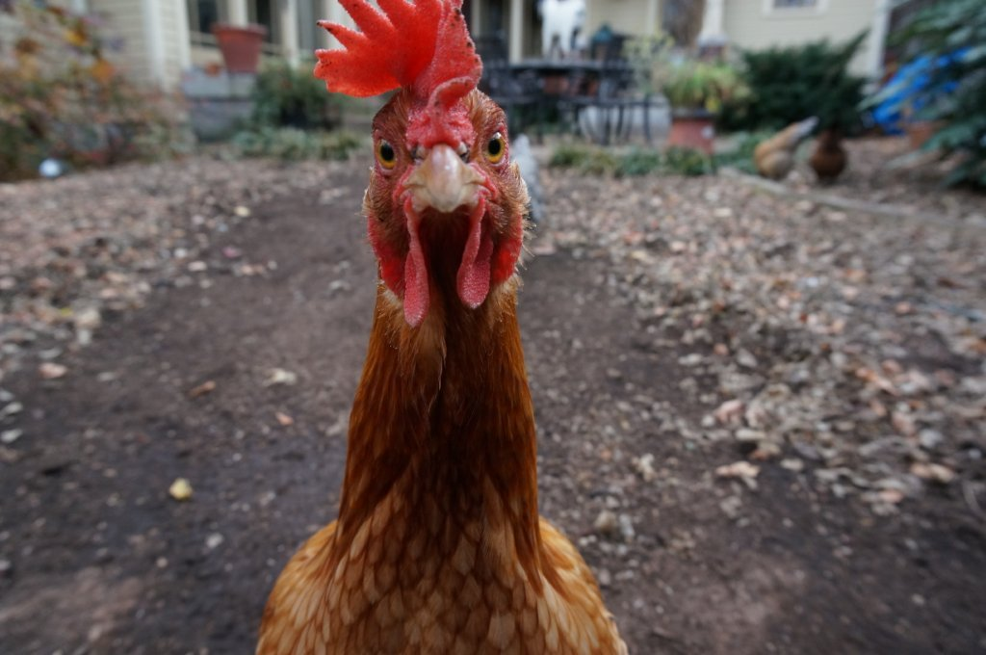
You asked 50 households in Athens if they keep chickens on their property. Three said they did. Create a confidence interval for the proportion of chicken owning households in the city.
Notes:
T distribution was created by William Gosset. Hired in 1902 at Guinness brewery to help maximize quality of beer at a lower cost.
Problem of how to measure taste with only small sample sizes (limit on how much beer one man can drink)
He had to publish his results without his name because of the privacy restrictions Guinness put on their employees. Just the name “Student”.
Thus his statistical method is still known today as Gosset’s t-test.

Slide 36
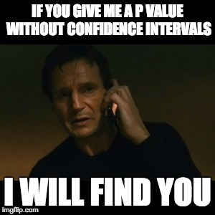
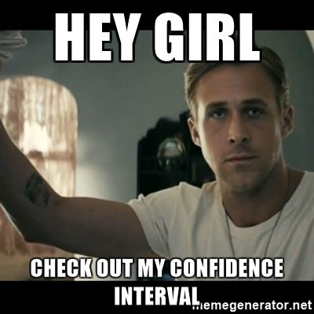
Next lecture: Confidence intervals in R
Notes:
T distribution was created by William Gosset. Hired in 1902 at Guinness brewery to help maximize quality of beer at a lower cost.
Problem of how to measure taste with only small sample sizes (limit on how much beer one man can drink)
He had to publish his results without his name because of the privacy restrictions Guinness put on their employees. Just the name “Student”.
Thus his statistical method is still known today as Gosset’s t-test.

